Slide 1
#19
As We Proclaim His Death
Scriptural Hymns Volume 1

Slide 2
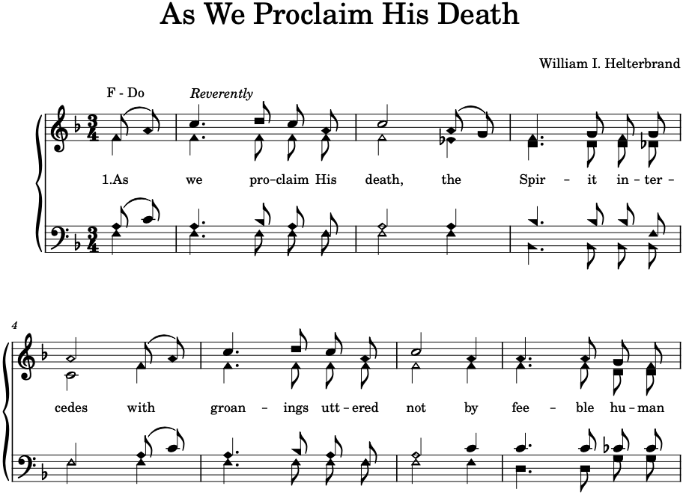

Slide 3
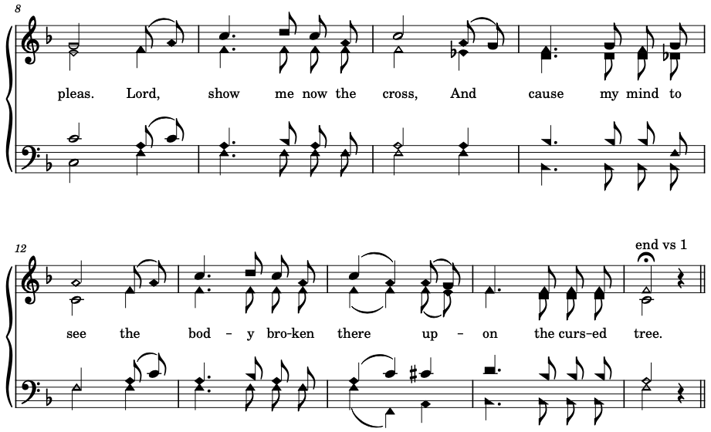

Slide 4
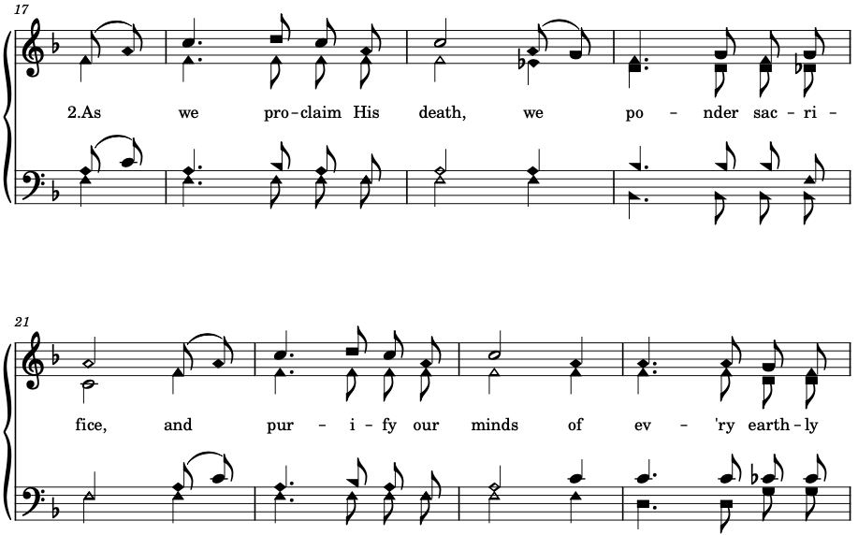

Slide 5
