Slide 1
#1
Mighty and Strong
Scriptural Hymns Volume 1

Slide 2
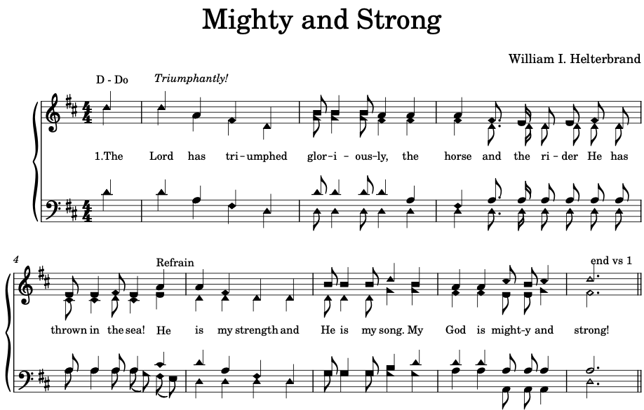

Slide 3
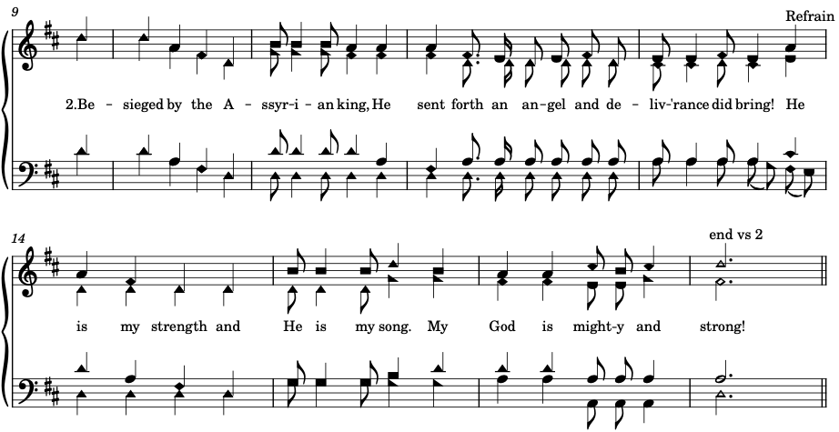

Slide 4



Slide 5
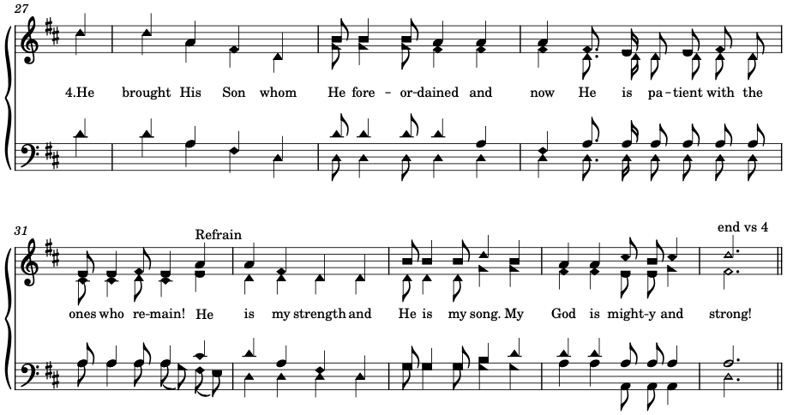

Slide 6
