Slide 1
#6
Unless God Builds (Psalm 127)
Scriptural Hymns Volume 1

Slide 2
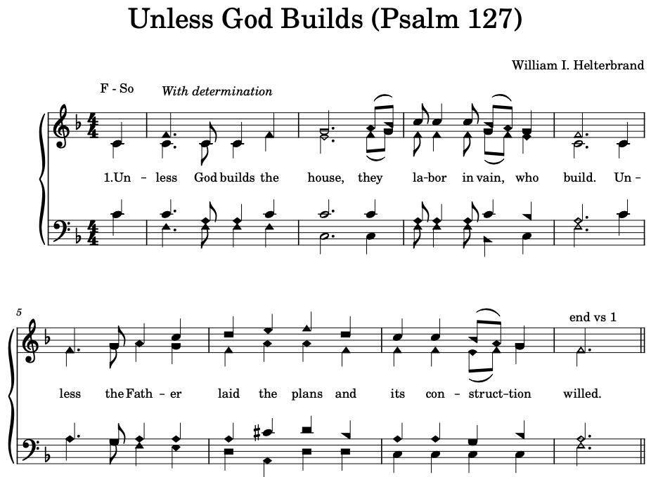

Slide 3
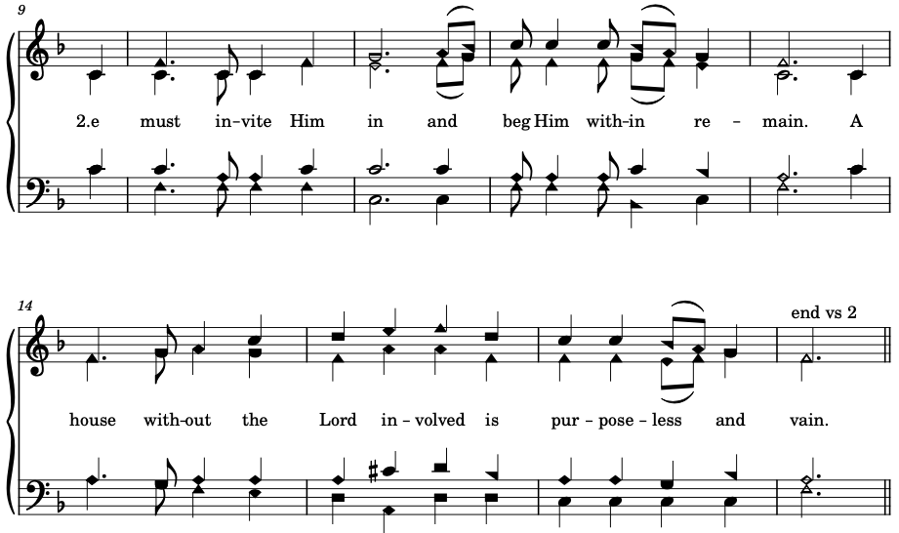

Slide 4
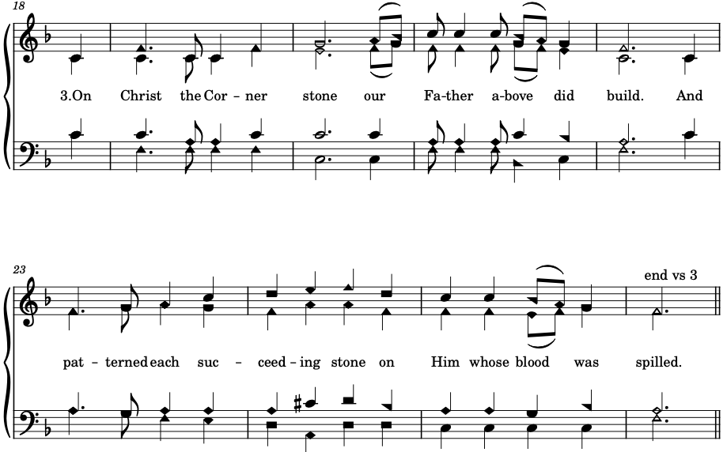

Slide 5
