Slide 1
#28
Song of the Elders
Scriptural Hymns Volume 1

Slide 2
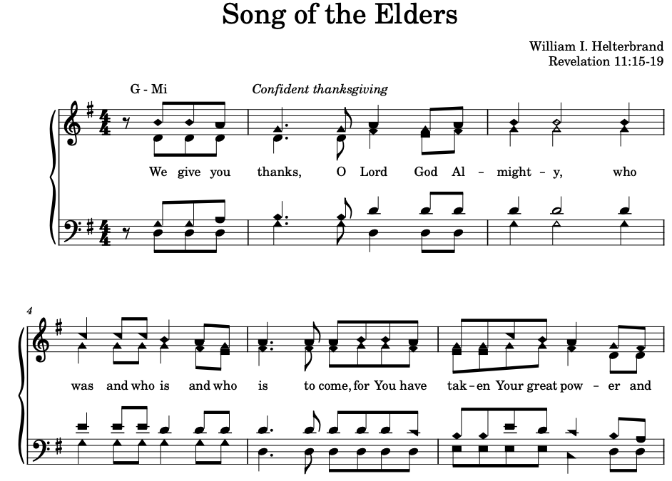

Slide 3
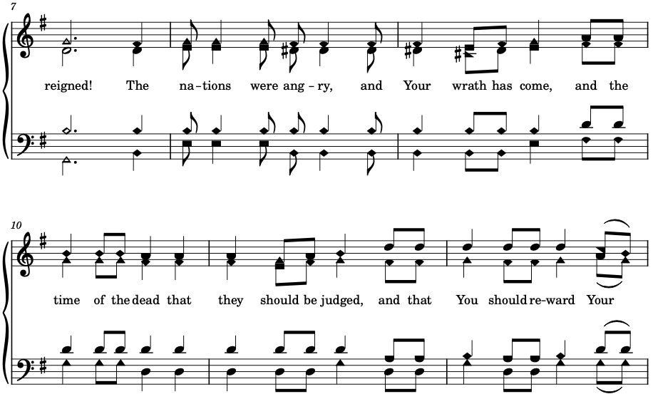

Slide 4
