Slide 1
#9
The Lord Takes Care
Scriptural Hymns Volume 1

Slide 2
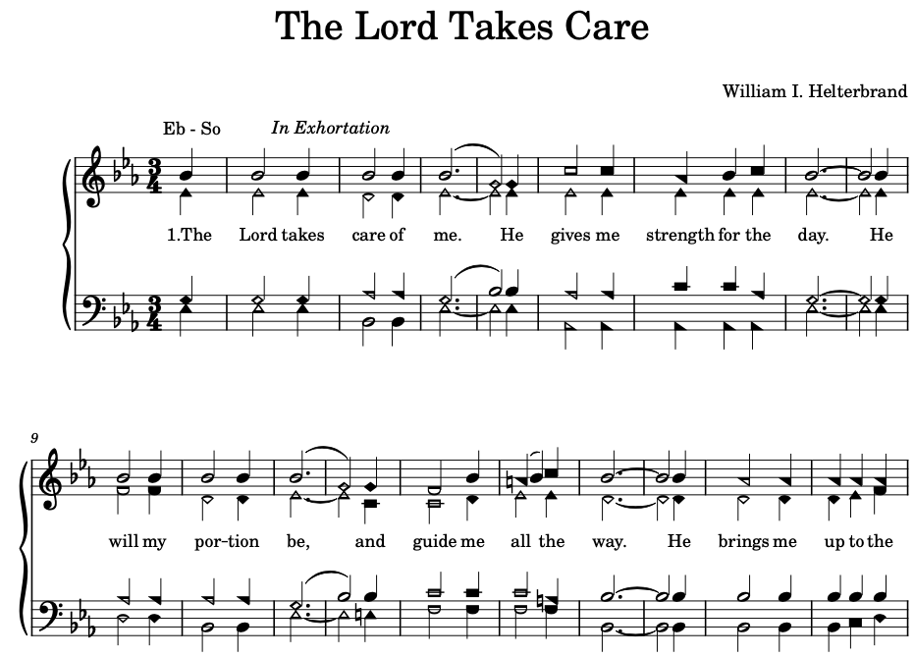

Slide 3
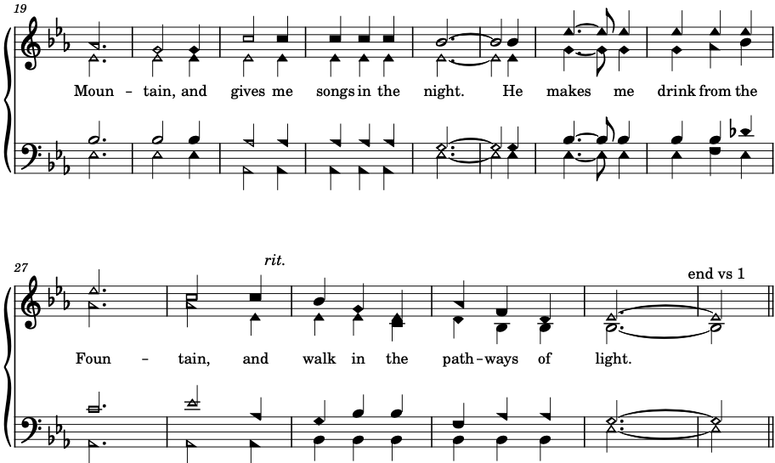

Slide 4
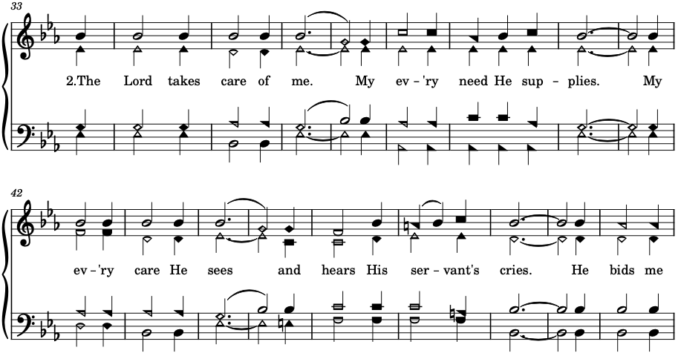

Slide 5
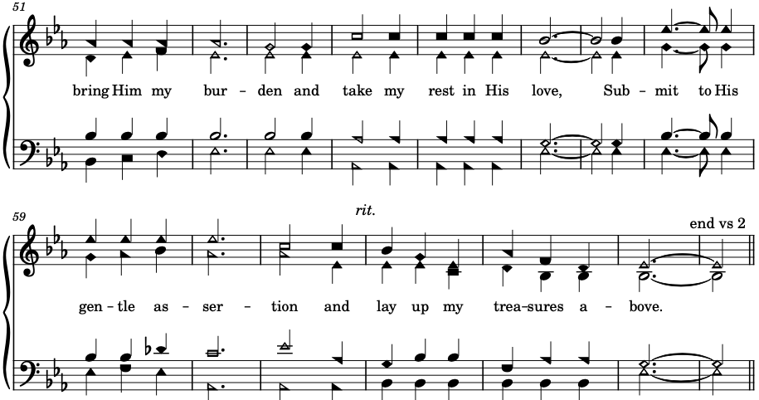

Slide 6



Slide 7
