Slide 1
#5
What A Day That Will Be
Scriptural Hymns Volume 1

Slide 2
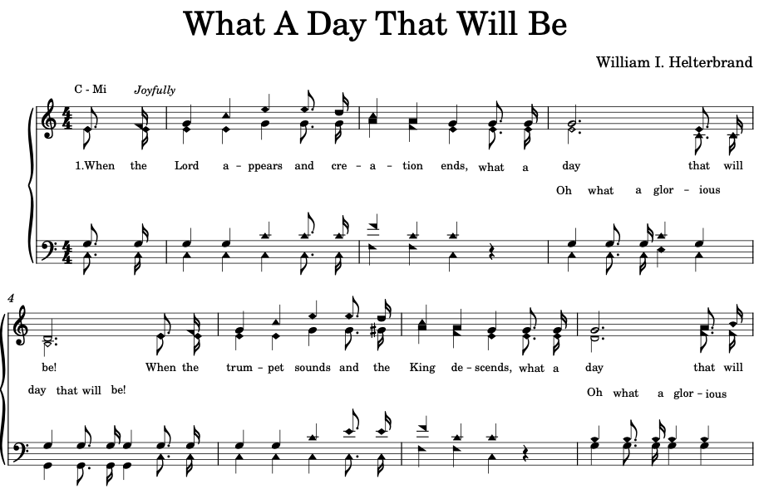

Slide 3
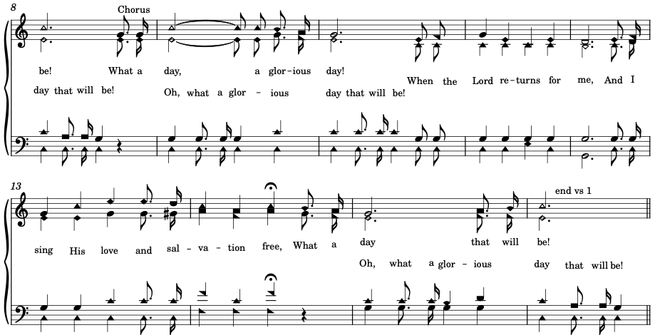

Slide 4



Slide 5
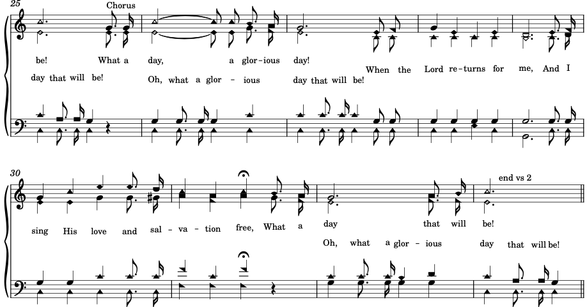

Slide 6
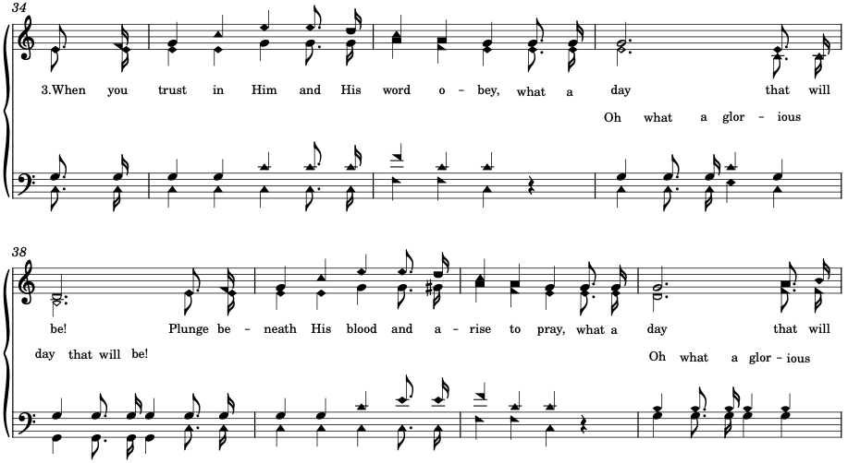

Slide 7


