Slide 1
#18
2 Timothy 3:12-4:8
Scriptural Hymns Volume 1

Slide 2
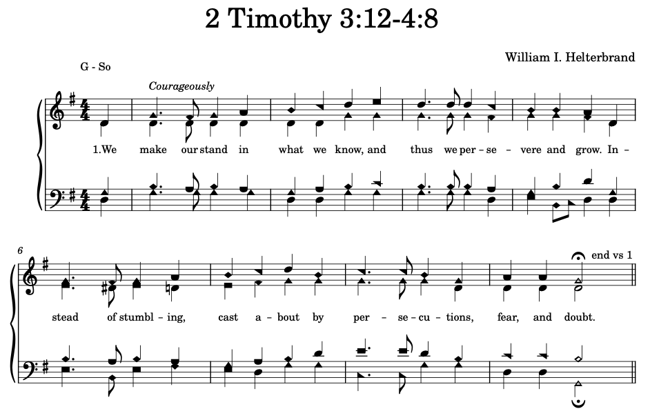

Slide 3
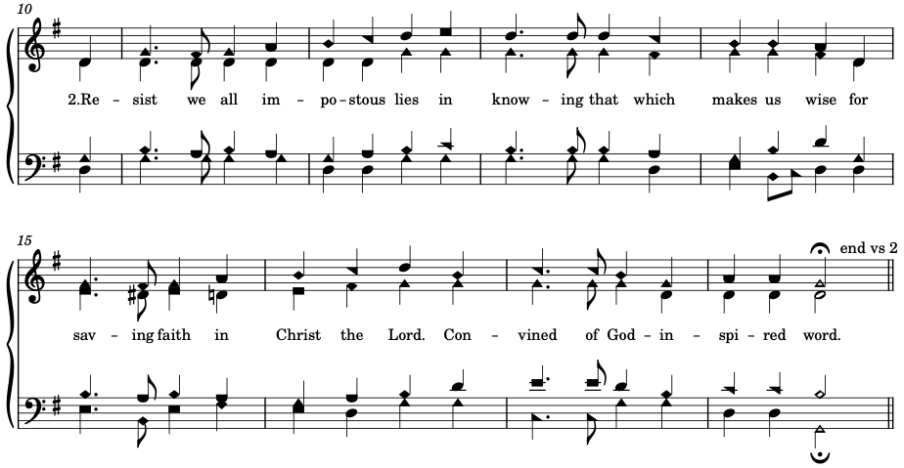

Slide 4



Slide 5



