Slide 1
#31
Exultation Over Babylon
Scriptural Hymns Volume 1

Slide 2
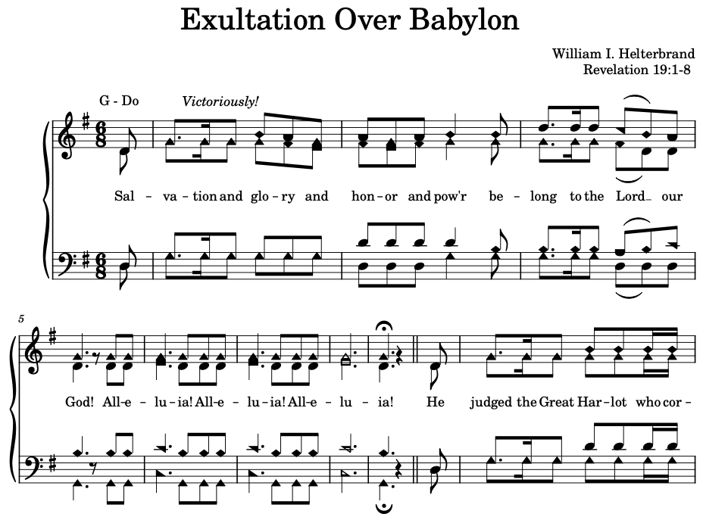

Slide 3
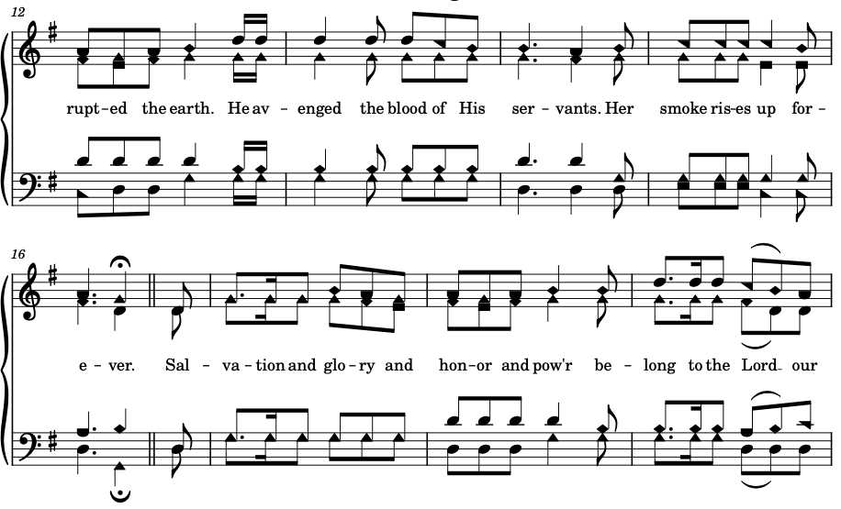

Slide 4
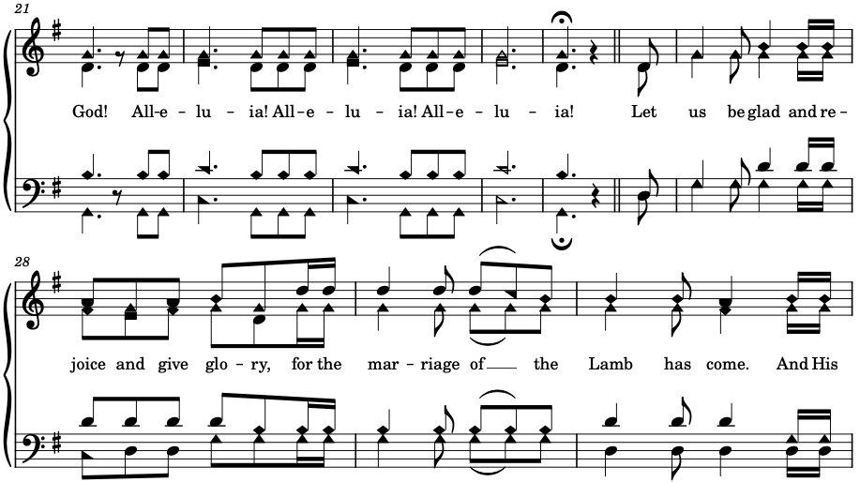

Slide 5
