Slide 1
#4
When My Children Ask Me
Scriptural Hymns Volume 1

Slide 2
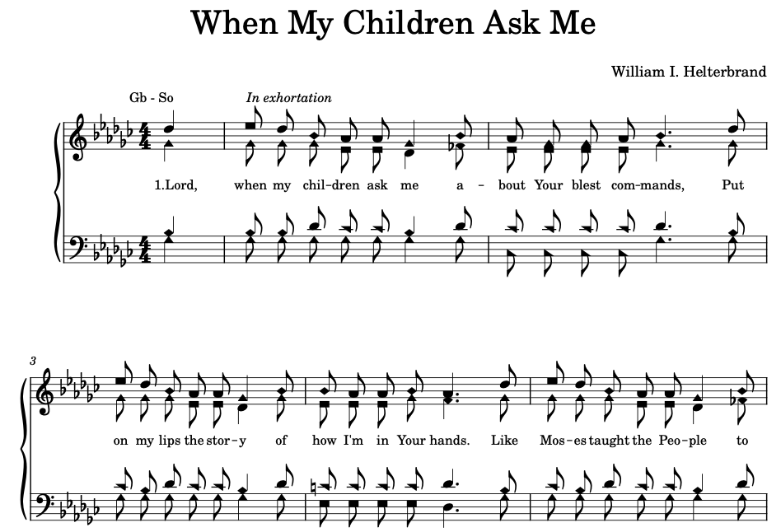

Slide 3
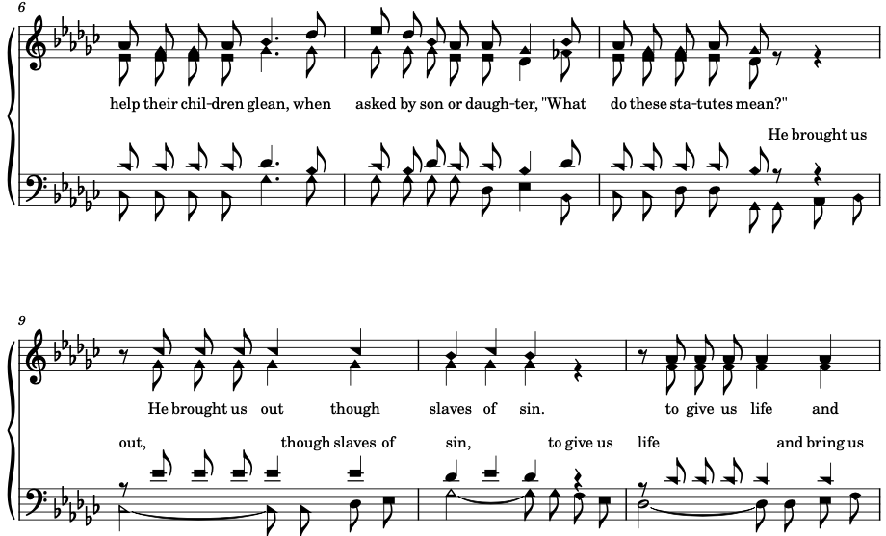

Slide 4
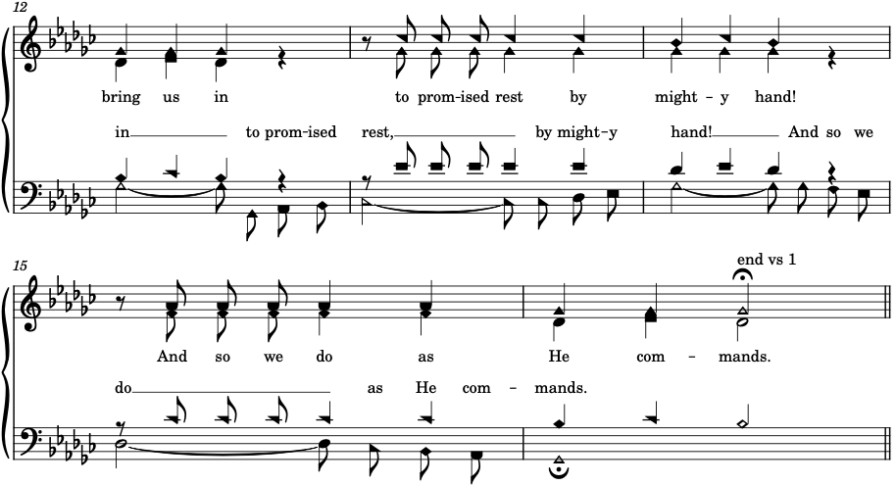

Slide 5
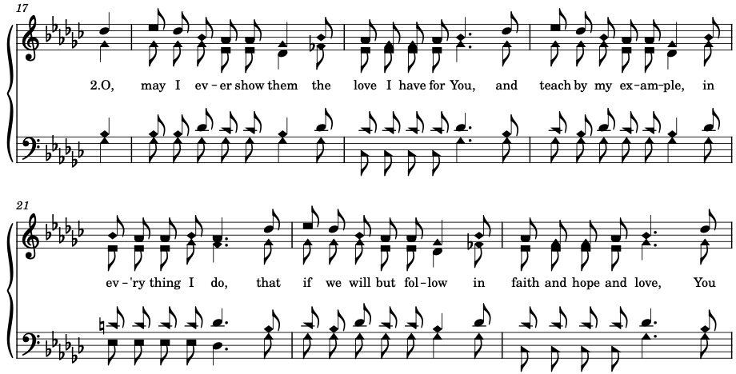

Slide 6



Slide 7


Slide 8
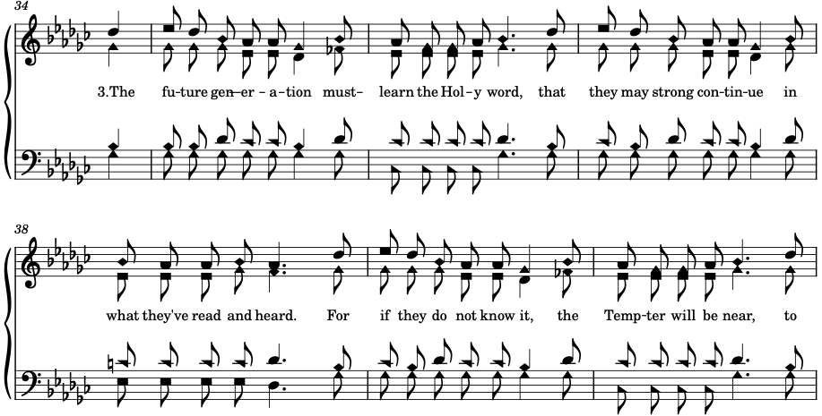

Slide 9



Slide 10
