Slide 1
#2
The God Who Sees
Scriptural Hymns Volume 1

Slide 2
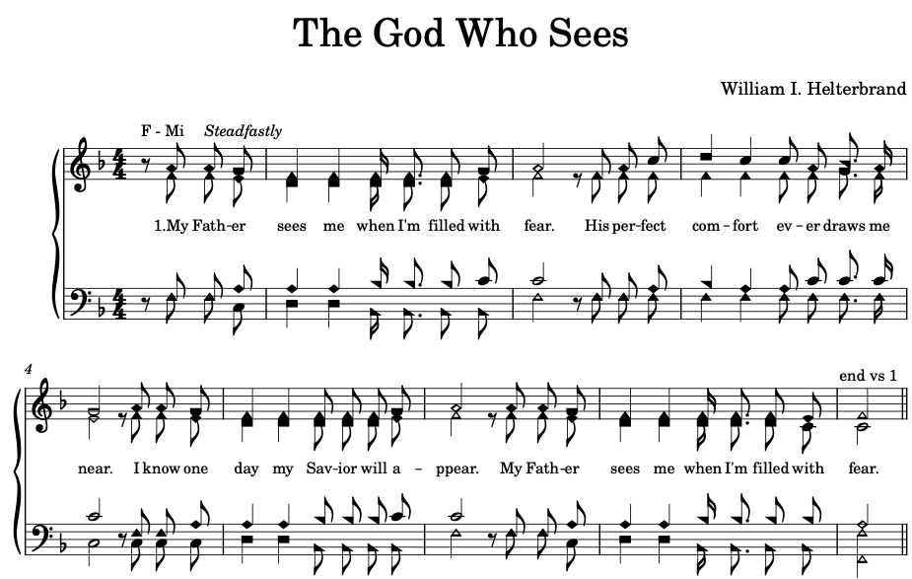

Slide 3
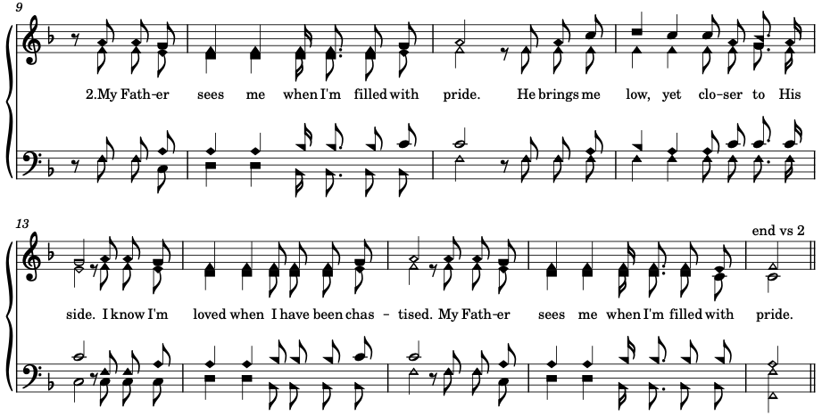

Slide 4



Slide 5
