Slide 1
#7
Households
Scriptural Hymns Volume 1

Slide 2
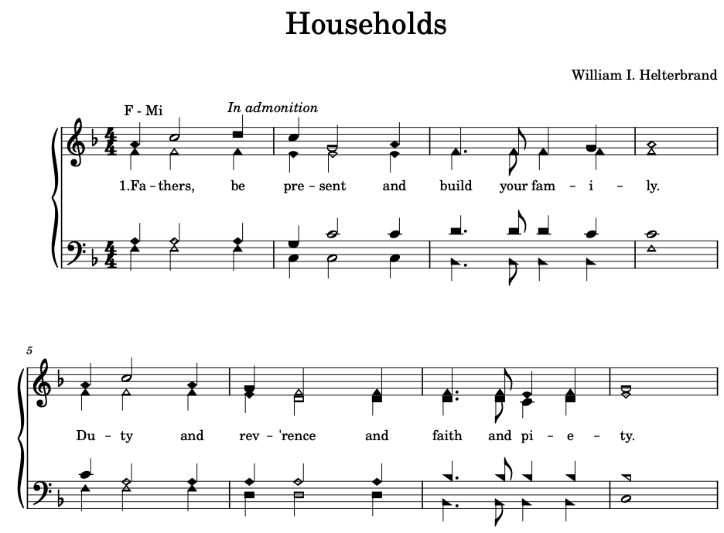

Slide 3
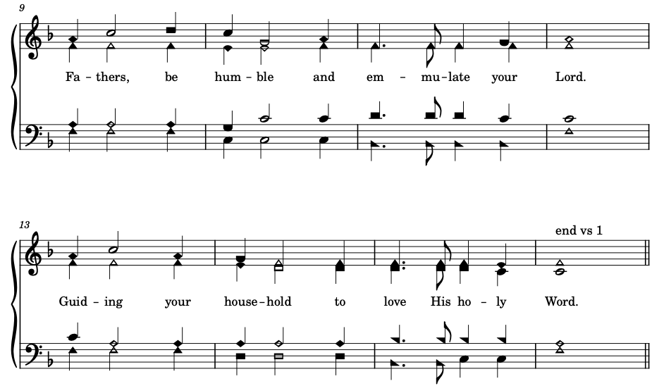

Slide 4
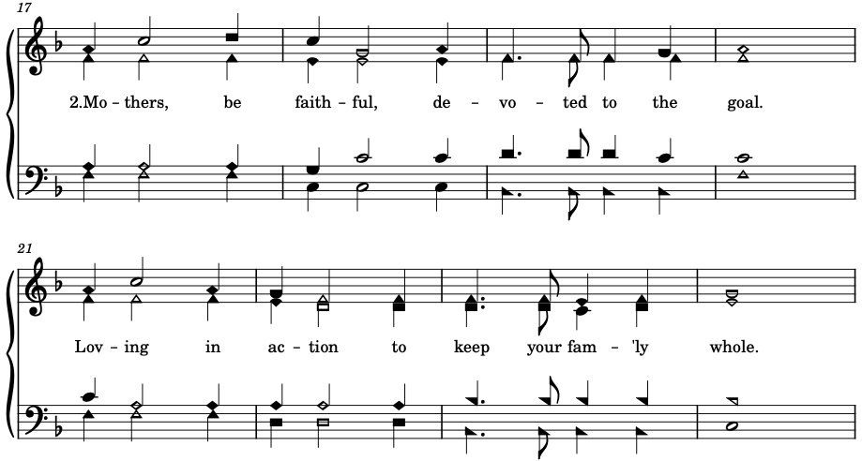

Slide 5
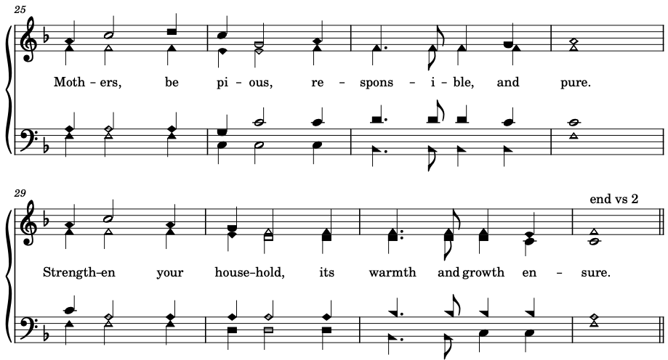

Slide 6



Slide 7



