Slide 1
#30
Righteous God of Righteous Judgment
Scriptural Hymns Volume 1

Slide 2
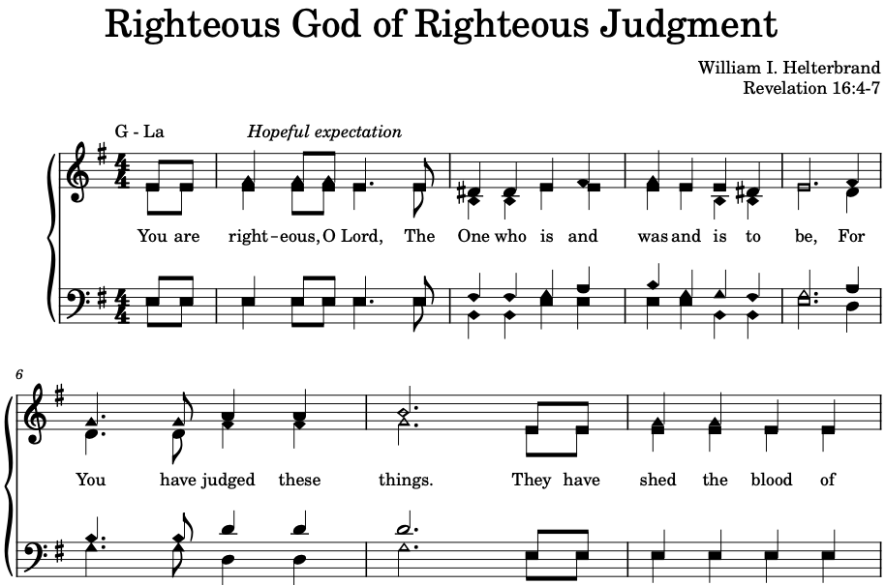

Slide 3
