Slide 1
#25
Worthy to Take the Scroll
Scriptural Hymns Volume 1

Slide 2
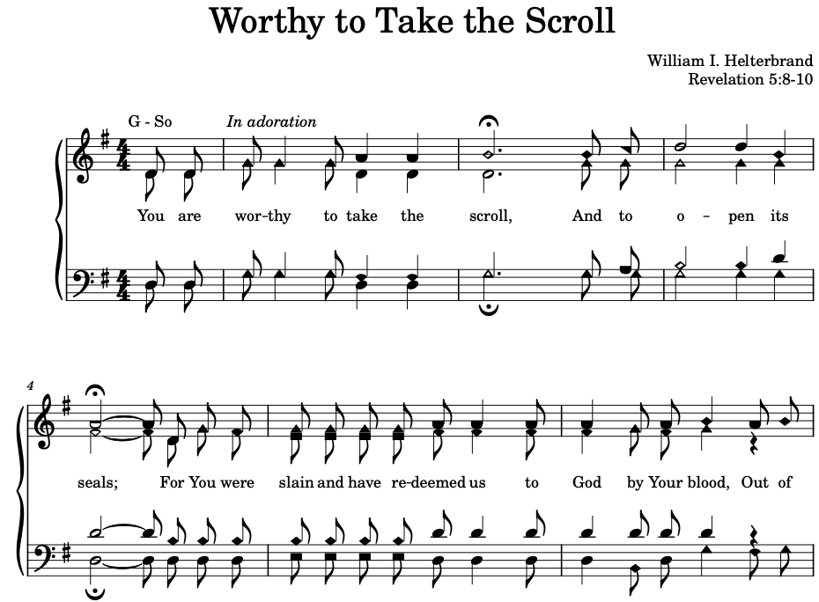

Slide 3
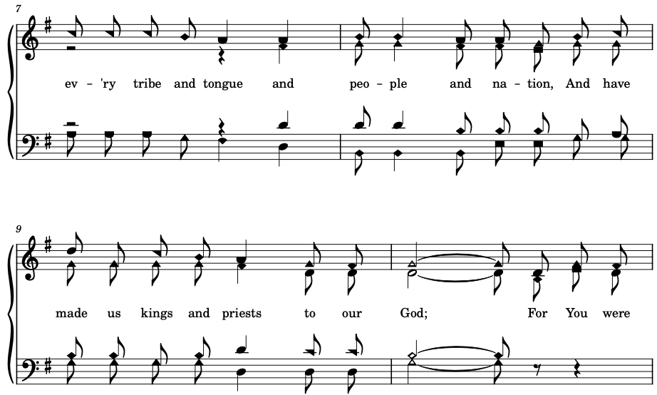

Slide 4
