Slide 1
#26
Worthy is the Lamb
Scriptural Hymns Volume 1

Slide 2
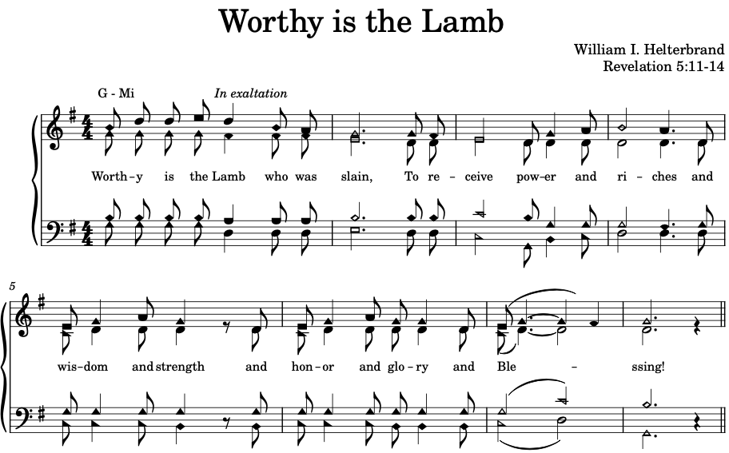

Slide 3
