Slide 1
#29
Praise on the Sea of Glass
Scriptural Hymns Volume 1

Slide 2
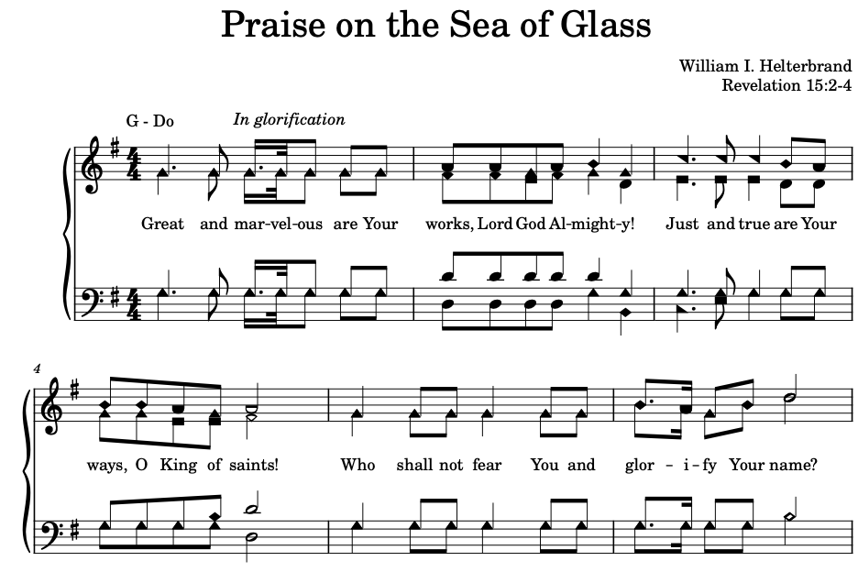

Slide 3
